Slide 1
MIKE 11 Short Introduction

Slide 2
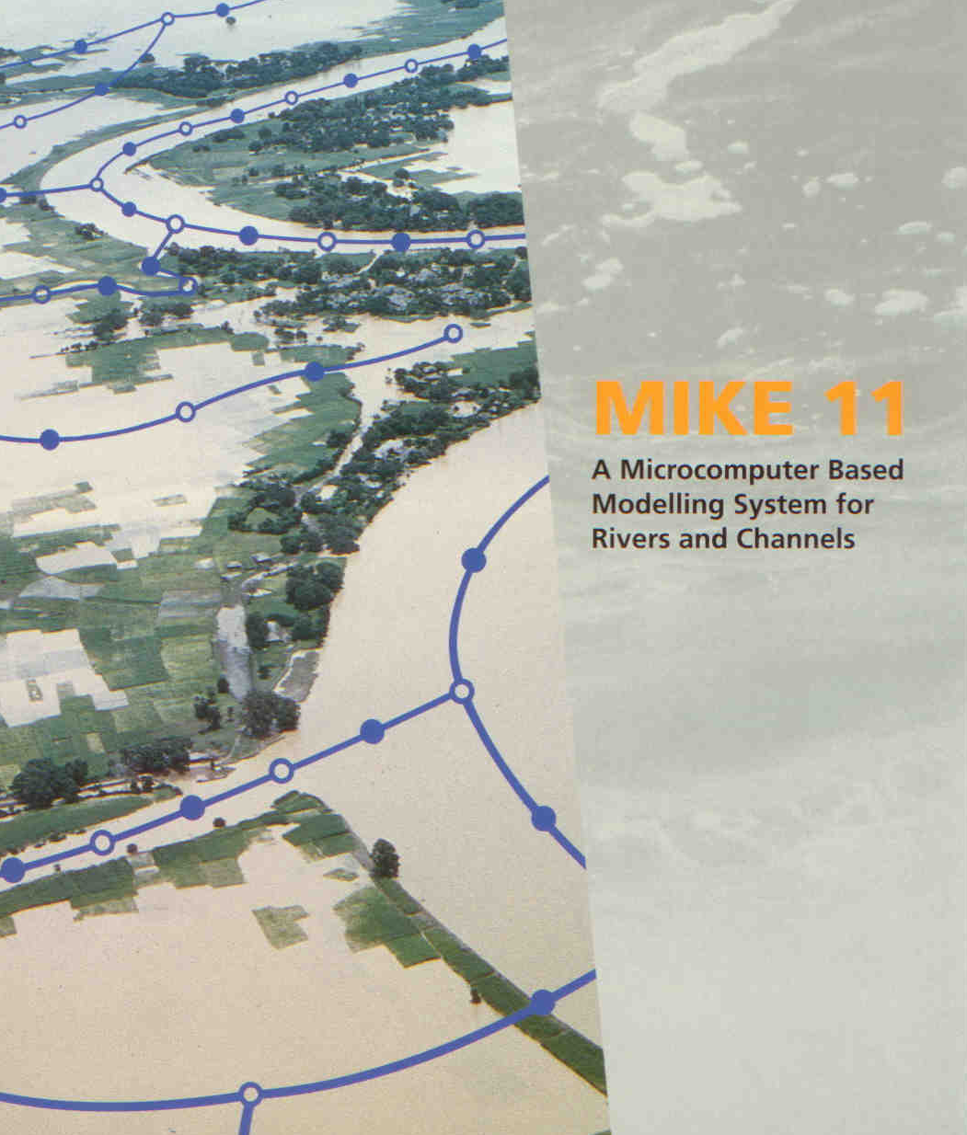
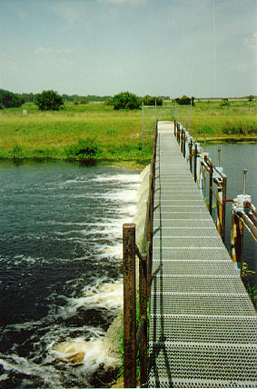
MIKE 11
A 1D Modelling System for Rivers, Channels and Reservoirs (and Structures)

Slide 3
Modelling the world of water

Slide 4
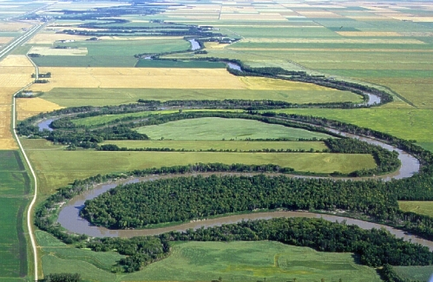
MIKE 11
A 1D Dynamic Modelling System for Rivers, Channels and Reservoirs (+ Structures)
MIKE 11 is applicable for simulating rivers and other open surface water bodies which can be approximated as 1-dimensional flow!
(as a strict 1-D flow does not occur in nature!)
MIKE 11 is a world standard in 1D river modelling for simulating flow and water level, water quality and sediment transport in rivers, floodplains, irrigation canals, reservoirs and other inland water bodies.
Application range is still very large from simple design investigations but also large forecasting projects including complex hydraulic structure operation policies.

Slide 5
MIKE 11 DEVELOPMENT HISTORY
1970: DHI leads development of generalised numerical modelling packages. System 11 and System 21 on Mainframe computers
1987: MIKE 11 becomes the second DHI software product (first: MOUSE). DOS-based PC adaption of System 11 Keyboard driven Menu-based User Interface MIKE 11 ‘Classic’
1997: MIKE 11 Version 4.0 First true Windows version based on the MIKE ZERO framework Graphical User Interface, Windows standards, 32-bit technology
2012: New engine: MIKE 1D launched in 2012 MIKE 1D common engine for 1D River and 1D sewer pipe simulation (MOUSE) GUI as introduced in 1997 Improved performance: parallelised, 64-bit, Component-based, Scripting enabled
Today: A well-consolidated product!
World wide applications!
Notes:
Spread and utilised worldwide.
Users/installations in all continents
Selected 1D modelling tool by authorities in several countries

Slide 6
MIKE 11 ENGINES
MIKE 11 from release 2012 and onwards: 2 engines
MIKE 1D (new) New generation of DHI’s 1D simulation engines Common engine for 1D River and 1D sewer pipe simulation Parallelised, 64-bit, Component-based, Scripting enabled HD, RR and Hydraulic structures included in first release only
MIKE 11 “Classic” Updated to 64-bit Increased memory allocation Larger models – slightly faster 2D Mapping features: Larger and higher resolution maps can be produced Result extraction tool; ‘Res11read.exe’ also 64-bit: Extraction possible from large result-files (> 1GB) Improved coupling of MIKE FLOOD (all engines 64-bit now)

Slide 7
MIKE 11 COMMON APPLICATIONS
Flood Forecasting - real-time, on-line
Flood studies - analysis & mapping - hazard & risk assessments - mitigation planning
River Restoration
Water Quality - wetlands, salinity
Dam breach
Most common MIKE 11 applications
Integrated modelling - Groundwater - Surface runoff - 2D surface flooding (MIKE FLOOD)
Structures operation Reservoirs management - operation, optimisation
Sediment transport - long-term morphological assessments

Slide 8
Versatile 1D Modelling Platform
Hydrodynamic modelling
Estuaries and Rivers
Irrigation Systems
Dambreak
Controllable Weirs
Flood Control
Flood Forecasting
Water Quality modelling
Balance of Dissolved Oxygen, Ammonia, Nitrate etc.
Eutrophication
Heavy Metals and Wetlands
Sediment Transport modelling
Cohesive Sediment
Non-cohesive Sediment
Morphological modelling
Advection Dispersion modelling
Salinity Intrusion
Temperature
Pollutant Transport

Slide 9
MODULAR STRUCTURE
Modules and Databases that Interact Dynamically
Rainfall-Runoff
Hydrodynamics
Flood Forecasting
Advection-Dispersion
Sediment Transport
Databases
Topographical Data
Time Series Data
Water Quality

Slide 10
HYDRODYNAMIC MODULE
Hydrodynamic Module, Core of MIKE 11
Saint Venant Equations
6 Point Abbott-Ionescu
Finite Difference Scheme
dynamic/diffusive/kinematic
Looped Network
Q
h
Q
h
h
h
Q

Slide 11
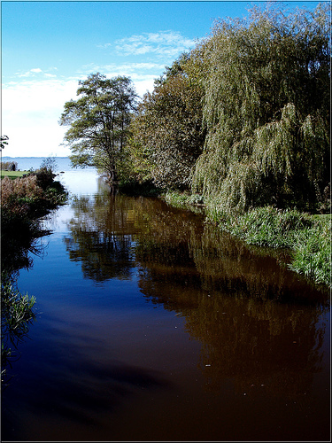
MIKE 11 BASIC DATA REQUIREMENTS
Solution of governing flow equations requires detailed descriptions of:
Catchment and Rivers Delineation
River and Floodplain Topography
Hydrometric Data for Boundary Conditions
Hydrometric Data for Calibration / Validation
Man-made Interventions (structures)

Slide 12
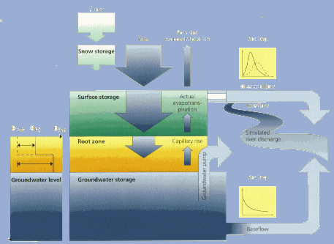
RAINFALL RUNOFF
Various Rainfall Runoff Methods
NAM
SMAP
Unit Hydrograph Method (UHM)
US Soil conservation Service models (SCS)
Flood Estimation Handbook (FEH, UK)
Urban A & B
DriFt
Distributed inflows along river/channel reaches

Slide 13
FLOOD FORECASTING
Real Time Forecasting (DA Module)
Linked to Real Time Data
Water Levels
Discharge
Inundation
Error Correction

Slide 14
ADVECTION DISPERSION
Transport of Conservative Matter (Dissolved and Suspended)
Pollutant Transport
Salinity Intrusion
Temperature and Plume Modelling
Advective Transport
Dispersive Transport
1st Order Decay
Cohesive Sediment (single/multi layer)
River
Sea

Slide 15
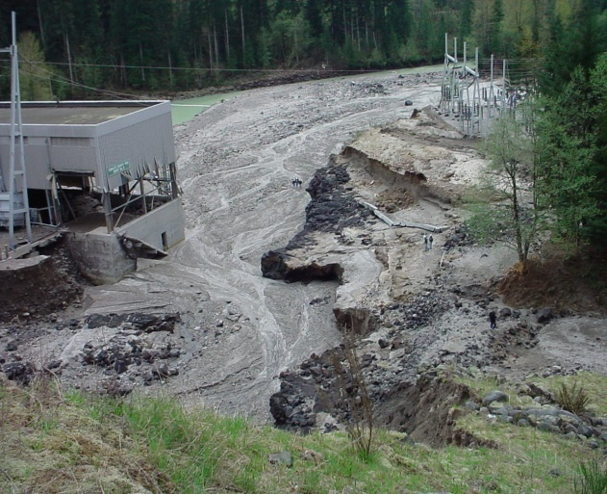
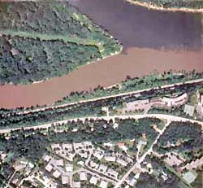
SEDIMENT TRANSPORT
Various Formulations and Modes
Cohesive ST
Non-cohesive ST:
Engelund-Hansen
Ackers-White
Engelund-Fredsøe
van Rijn
Smart-Jaeggi
3 ST sub-modules:
MIKE 11 ACS (Advanced Cohesive Sediments)
MIKE 11 ST (non-cohesive)
MIKE 11 GST (graded sediments)
Suspended
Load
Bedload
Passive

Slide 16
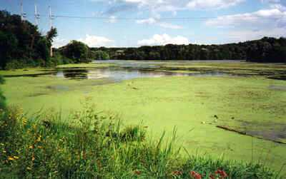
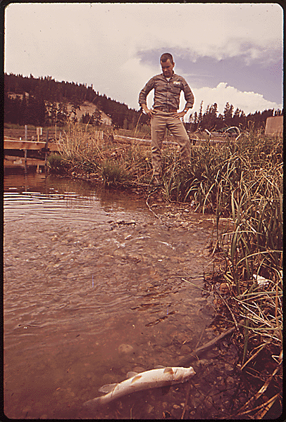
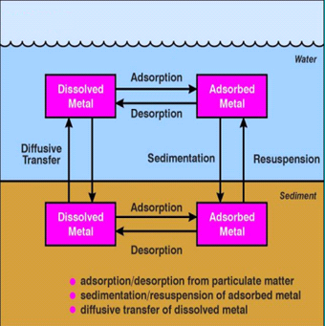
WATER QUALITY (ECOLab)
Modelling of Water Quality Processes
Nutrients and Biological Oxygen Demand
Eutrophication
Phyto-plankton
Zoo-plankton
Chlorophyll-a
Carbon, Oxygen
Nitrogen, Phosphorous
Heavy Metals
Dissolved
Absorbed
Suspended
Pore-water
Bed Sediment
BOD, NO₃, NH₃, DO
Ecological Modelling (ECOLab)

Slide 17
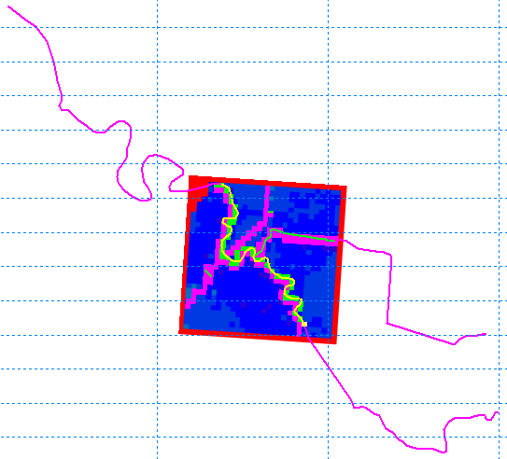
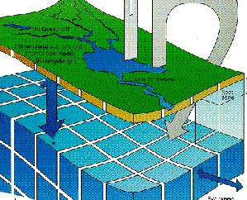
INTEGRATED MODELLING
Dynamic Couplings
MIKE 11 links to different models
MIKE FLOOD (1D-2D coupling)
MIKE 11 - MIKE 21 – MIKE URBAN
Groundwater/Surface water modelling
MIKE 11 - MIKE SHE
MIKE 11 - FEFLOW

Slide 18
DATABASES
Topographical and Time Series Data
Topographical Data:
Channel cross-sections
Floodplain topography
Channel & Floodplain Roughness
Structure geometry
Time Series Data:
Calibration and Verification
Boundary conditions:
Water levels
Discharges
Q-h boundary data
b (storage width)
floodplain
channel
floodplain
h (elevation)
Discharge [m3/s]
Time

Slide 19
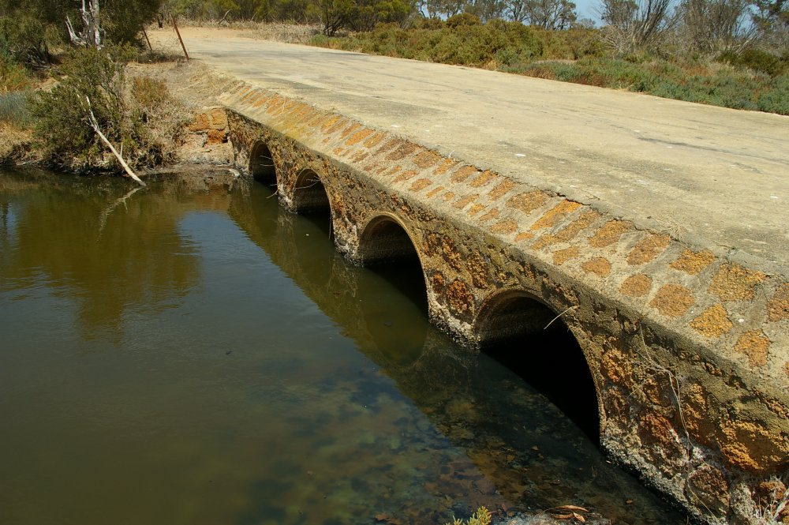
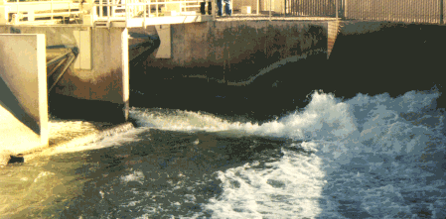
STRUCTURES
Large Selection of Structures
Simple Structures:
Weirs
Culverts
Bridges
Gates
Pumps
Advanced Structures:
User Defined
Regulation and Control Structures
Dambreak Mechanisms

Slide 20
WHY USE A DYNAMIC MODEL?
Because of Storage Effects
Dynamic Modelling:
takes into account the available storage volume in the channels and associated floodplains
allows for attenuation and delay of the rising flood peak as floodwaters slowly move onto the floodplain
allows water to be slowly conveyed back to the river when the flood recedes
Yamuna 37km
Yamuna 120km
Yamuna 220km

Slide 21
MIKE 11 Model Setup
Access All Files Through the Simulation File
Network Editor (.nwk11)
Cross Section Editor (.xns11)
Simulation Editor (.sim11)
Boundary Editor (.bnd11)
Parameter Editor (.HD11)
Time Series Editor (.dfs0)

Slide 22
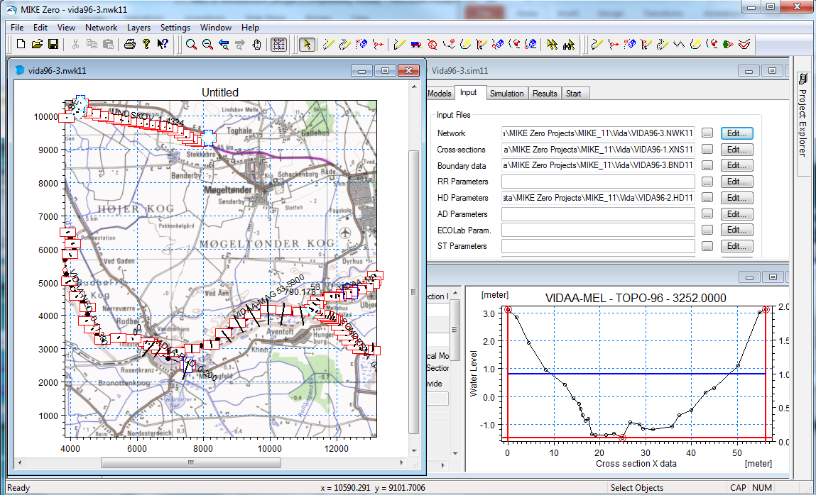
MIKE 11 GUI
Graphical and Tabular Views combined in various data-editors.
Network Editor the key element for data editing and presentation.

Slide 23
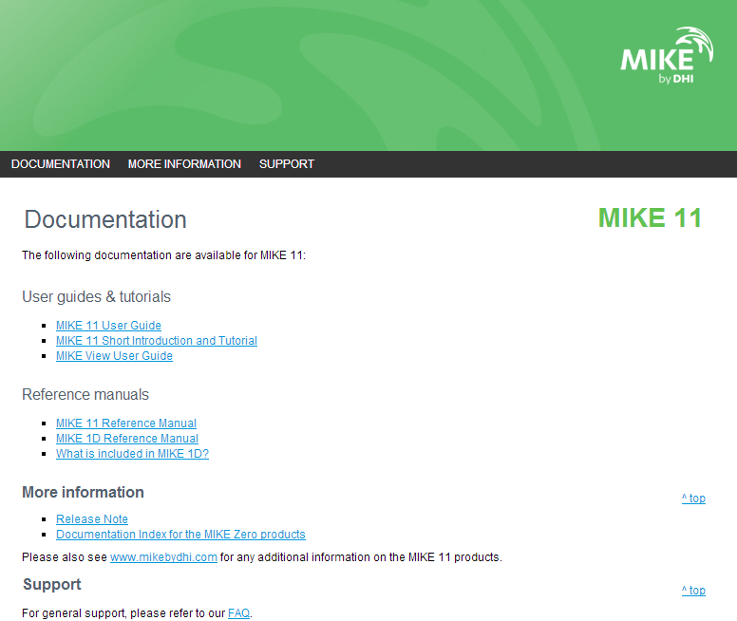
MIKE 11 DOCUMENTATION
Where to find Documentation and Additional Information?
Start > All Programs > MIKE by DHI 20xx > MIKE Zero > Documentation > MIKE 11 Documentation Index

